Slide 1


Amazon Sales Data Analysis
By Nrupraj Bhendarkar

Slide 2
Week 1

Slide 3

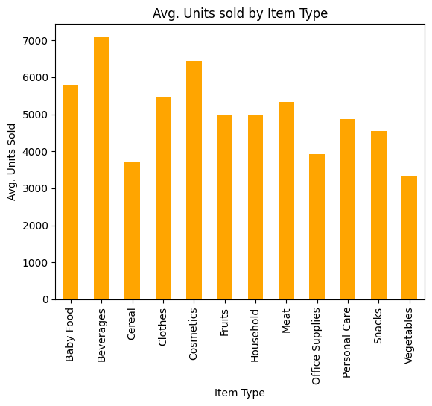

Introduction
Amazon.com is an international e-commerce company that offers online retail, computing services, consumer electronics, digital content, and other local services such as daily deals and groceries. Headquartered in the United States, Amazon hit nearly 514 billion U.S. dollars in net sales revenue worldwide in 2022. Most of the company's revenue is generated through e-retail sales of different categories of products, followed by third-party seller revenues, retail and media subscriptions, and AWS cloud services. Due to its global scope and reach, Amazon is considered one of the most valuable brands worldwide.
Amazon Avg Unit sold by item type

Slide 4
Project Titlec | Analyzing Amazon Sales Data
Technologies | Data Science
Domain | E-Commerce
Project Difficulties Level | Advanced
Amazon Sales Data Analysis
Resources
Name : Amazon Sales data
Dataset : Download Dataset

Slide 5

Problem Statement
Sales management has gained importance to meet increasing competition and the need for improved methods of distribution to reduce cost and to increase profits. Sales management today is the most important function in a commercial and business enterprise.
KPIs: ETL: Extract-Transform-Load
To Do
ETL: Extract: Transform-Load some Amazon dataset
Find Sales-trend -> month-wise, year-wise, yearly_month-wise
Find key metrics and factors
Show the meaningful relationships between attributes.

Slide 6

Architecture
Data Pre-processing
Real World
Data Cleaning
Model Deployment
Exploratory Data Analysis(EDA)
Model Building
Reporting

Slide 7
Raw Data Collection : The Dataset Provided by CollegeRanker Plateform.
Data Pre-Processing : Before building any model, it is crucial to perform data pre-processing to feed the correct data to the model to learn and predict. Model performance depends on the quality of data fed to the model to train.
Architecture Description
Data Cleaning : is the process of fixing or removing incorrect, corrupted, incorrectly formatted, duplicate, or incomplete data within a dataset.
Exploratory Data Analysis (EDA) : refers to analyze and investigate data sets and summarize their main characteristics, often employing data visualization methods.
Reporting : is the process of collecting and formatting raw data and translating it into a digestible format to assess the ongoing performance of your organization.

Slide 8
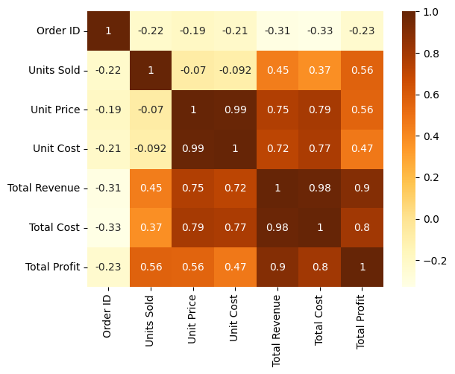
Analysis using Python

Slide 9
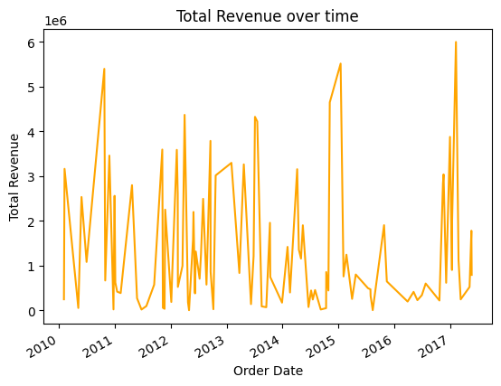
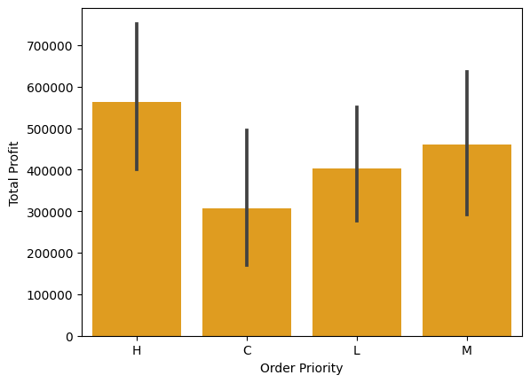
Analysis using Python

Slide 10
Week 2

Slide 11
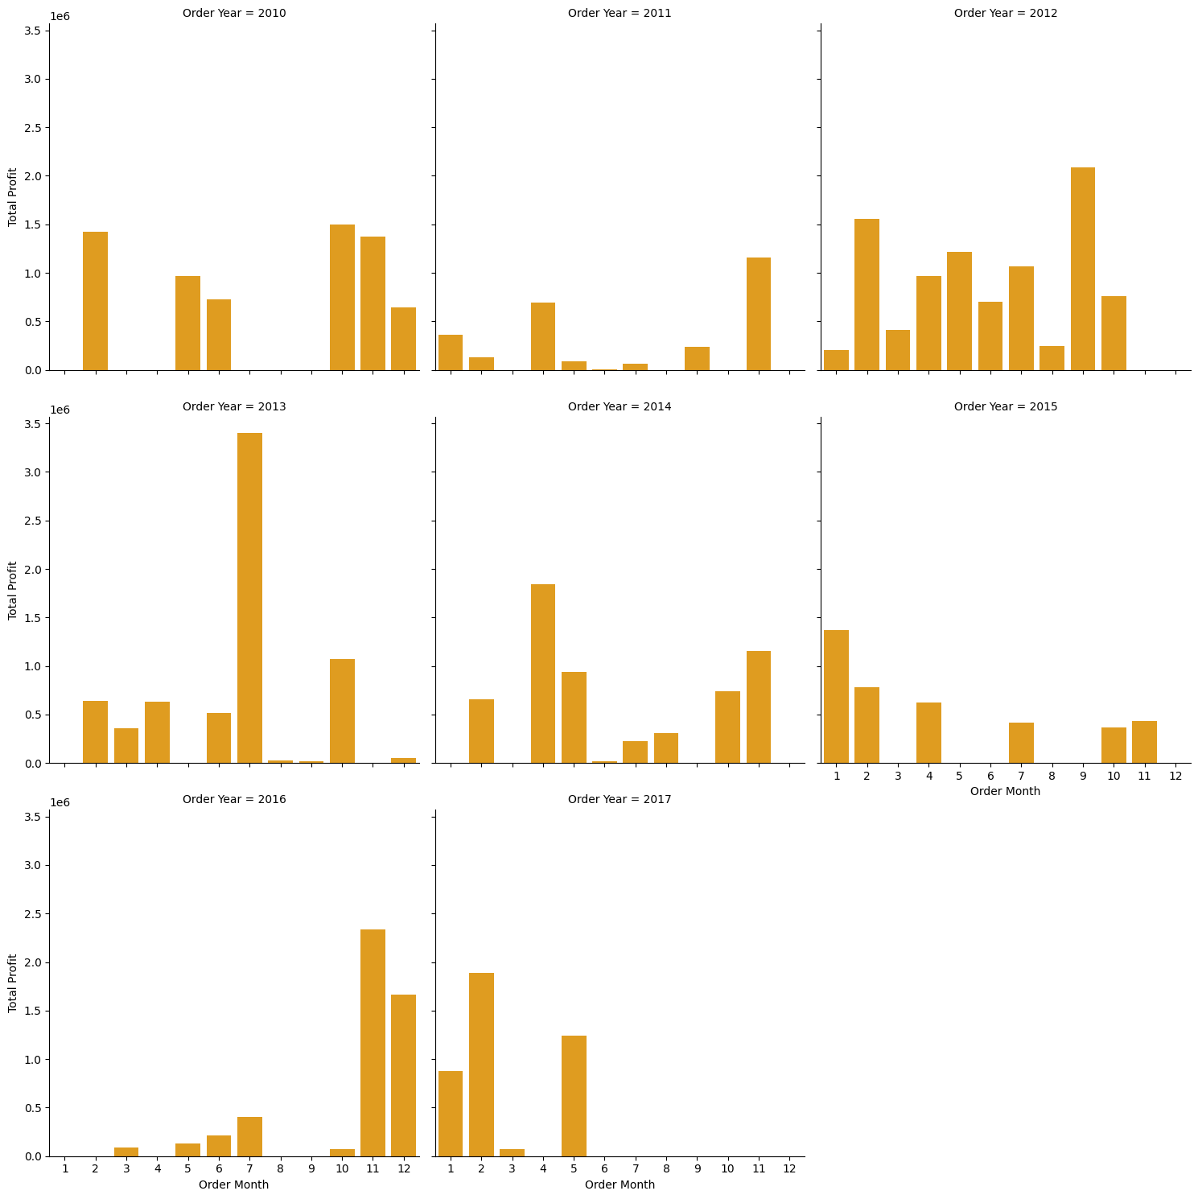
Analysis using Python

Slide 12
Tableau Dashboard

Slide 13
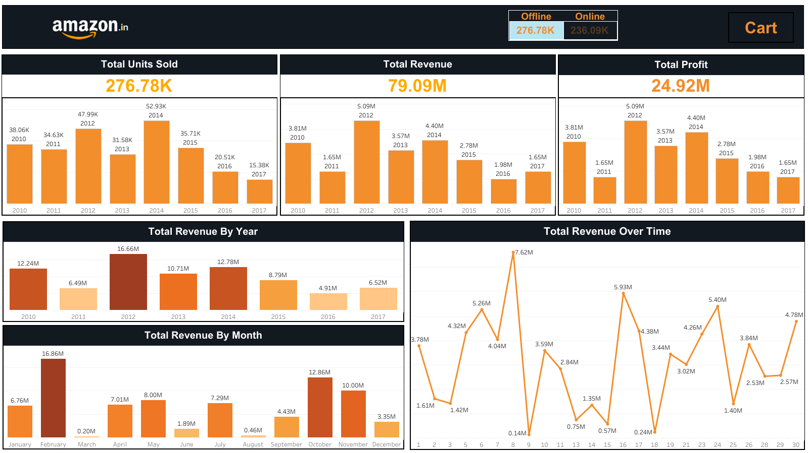
Tableau Dashboard

Slide 14
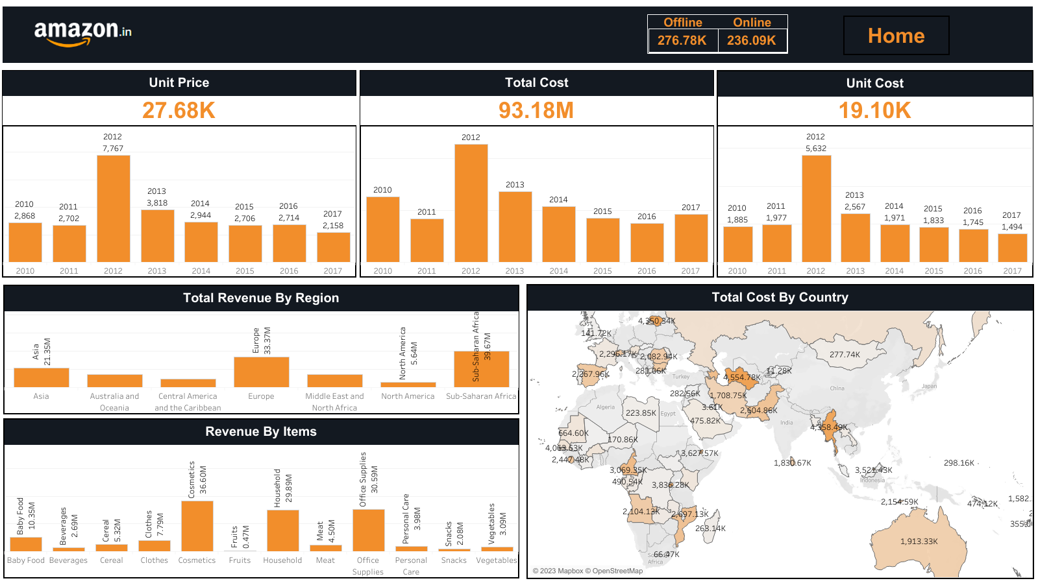

Slide 15
PROJECT WORK
Python Notebook
Check Here
Tableau Dashboard
Check Here

Slide 16


